Slide 1
Chapter 18
How to deploy a website on a web server

Slide 2
Objectives
Applied
Deploy a website to a web server that has Internet access.
Get your website into the major search engines and directories.
Knowledge
Explain how to get a web host and a domain name.
Describe the use of an FTP program for transferring files to and from a website on a server.
Describe the process of testing a website after it has been deployed.
Describe the process for getting your website into search engines and directories.
Describe two ways to control which pages on your site are indexed.

Slide 3

The home page for a web host

Slide 4
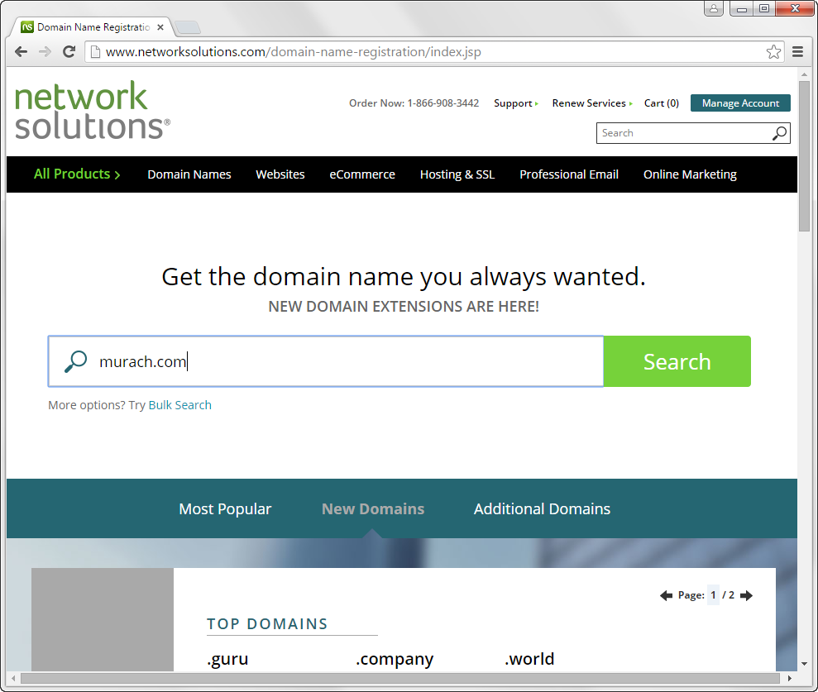
Searching for a domain name on a web host

Slide 5
How to install FileZilla Client
Go to the FileZilla website (www.filezilla-project.org).
Click on the Download FileZilla Client link.
Follow the instructions to install the FileZilla Client application on your system.

Slide 6
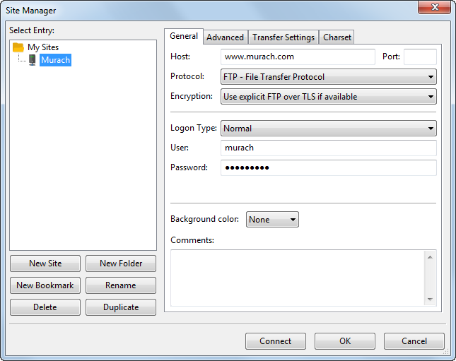
FileZilla’s Site Manager dialog box

Slide 7
How to connect to a website on a web server
Start FileZilla, and then use the File→Site Manager command to display the Site Manager dialog box.
Click the New Site button and enter a name for the site.
Enter the details needed to connect to the site, including the host name, user name, and password.
Click the Connect button to save the connection settings and connect to the site.
How to connect to a website the second time
Open the Site Manager, click on the site name, and click the Connect button.
How to edit the settings for a website
Open the Site Manager, click on the site name, edit its settings, and click the OK button.

Slide 8
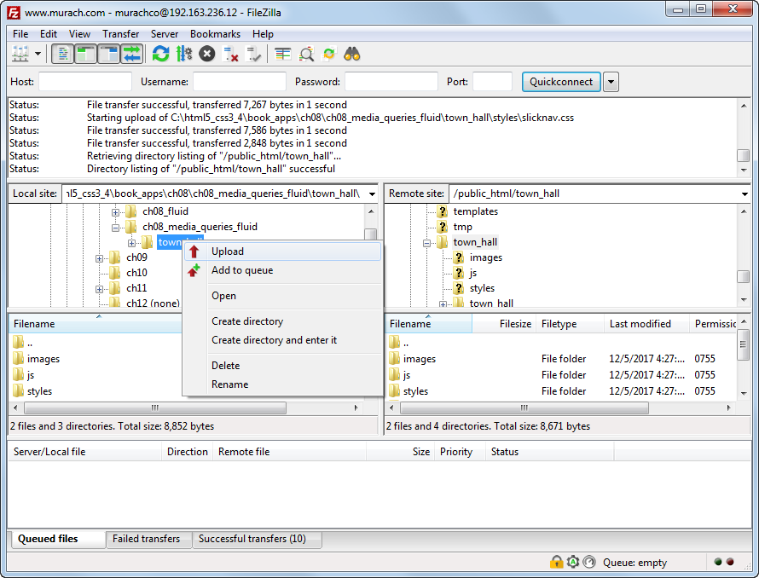
FileZilla when it is connected to a web host

Slide 9
How to test a web page that you’ve just deployed
Start your web browser, go to your home page, and navigate to the new page using every route that your site has for getting there.
Review the contents for the page, and make sure it’s all there and it all works, including the images and JavaScript features.
Test all the links on the page to make sure they work correctly.
Retest the page in all of the other browsers to make sure it works correctly in those browsers too.

Slide 10
How to test a new website
Methodically review all of the pages and test all of the links, one page at a time.
Do this for each of the browsers that your users might be using.

Slide 11
The major search engines
Google
Bing

Slide 12
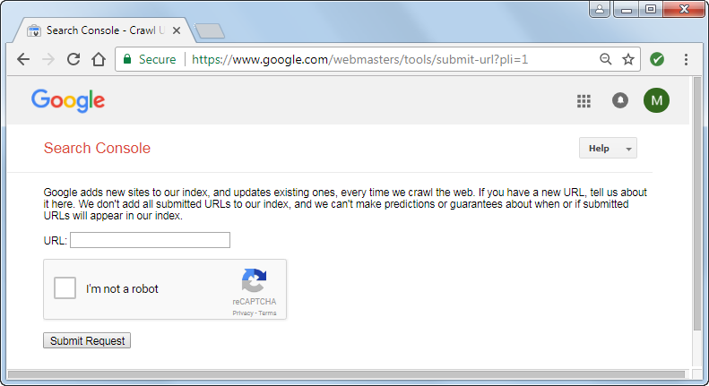
The Google page for submitting your site

Slide 13
Three robots.txt files
A file that tells all search engines not to index the pages in the cart folder
User-agent: *
Disallow: /cart/
A file that tells all search engines not to index the pages in two folders
User-agent: *
Disallow: /cart/
Disallow: /private/
A file that tells all search engines not to index one folder and one file
User-agent: *
Disallow: /cart/
Disallow: /backlist/private.html

Slide 14
Meta tags for page indexing
A meta tag that tells a robot not to index a page or follow its links
<meta http-equiv="robots" content="noindex, nofollow">
A meta tag that redirects the user from a deleted page to a current page
<meta http-equiv="refresh" content="0“
url="../asp5_cs.html">

Slide 15
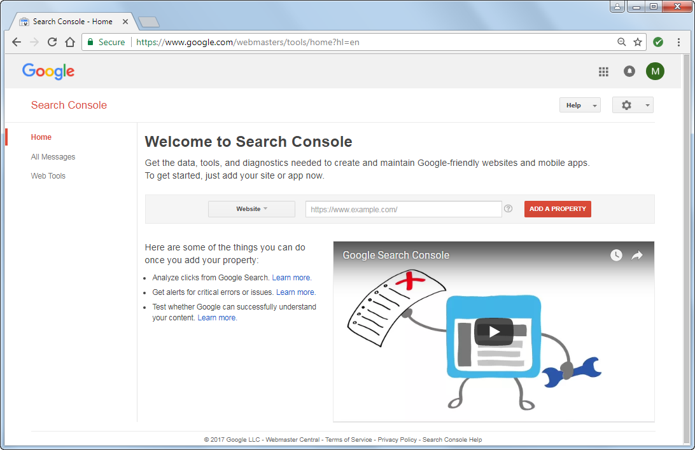
The Google Webmaster Tools website

Slide 16
Popular tools for checking the health of a website
Google Webmaster
SiteImprove
Hubspot’s Marketing Grader
FreeGrader
Nibbler
Woorank

